Slide 1

Small Embedded Language Model
Timur Ishuov

Slide 2

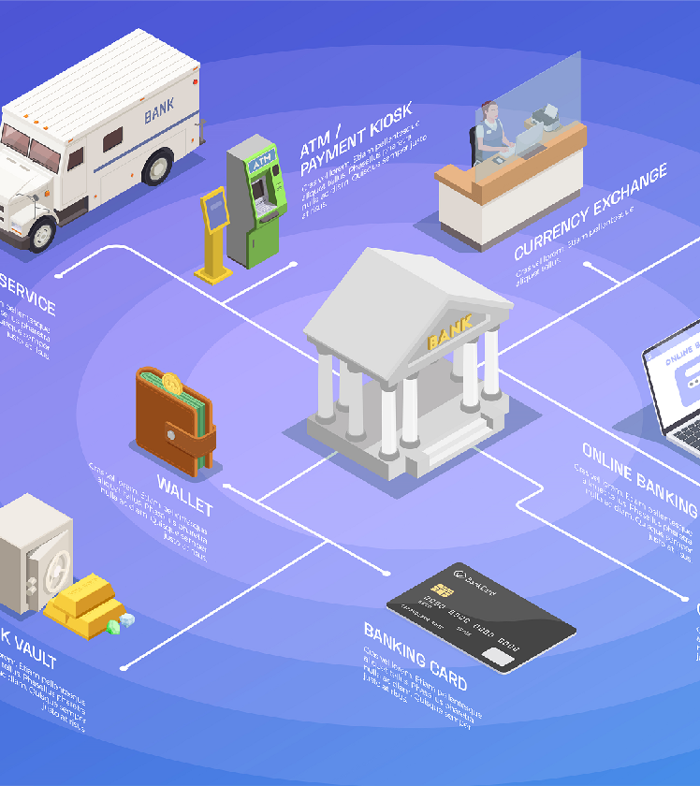
We are small bank (2 Office and 10 ATMs) And we want to convert to Bitcoin Bank platform

Slide 3
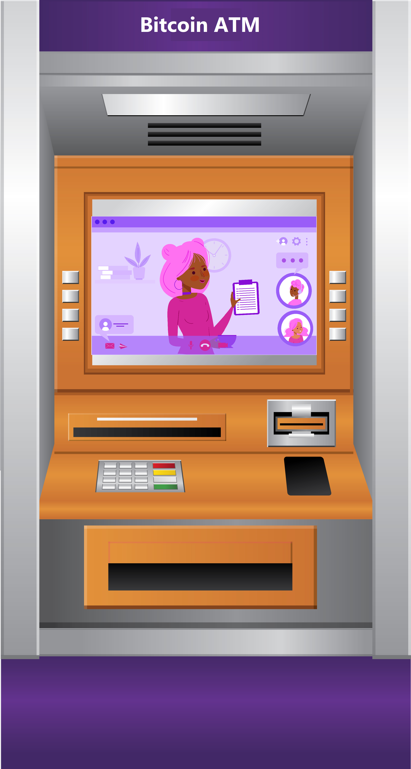

Slide 4
Software/Hardware on 70% of ATM in the world:
Windows 7
Intel Core i3 -i5
512/1024 Gb Ram
No GPU or embedded simple GPU
Top devices has (30%):
Windows 10
Intel Core i7
1024-2047 Gb Ram
embedded simple GPU

Slide 5
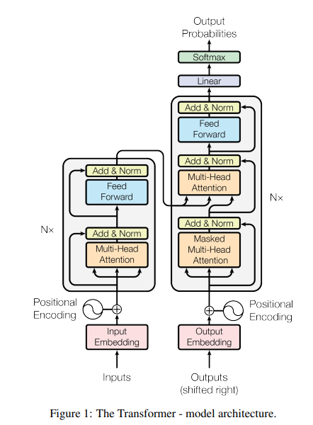
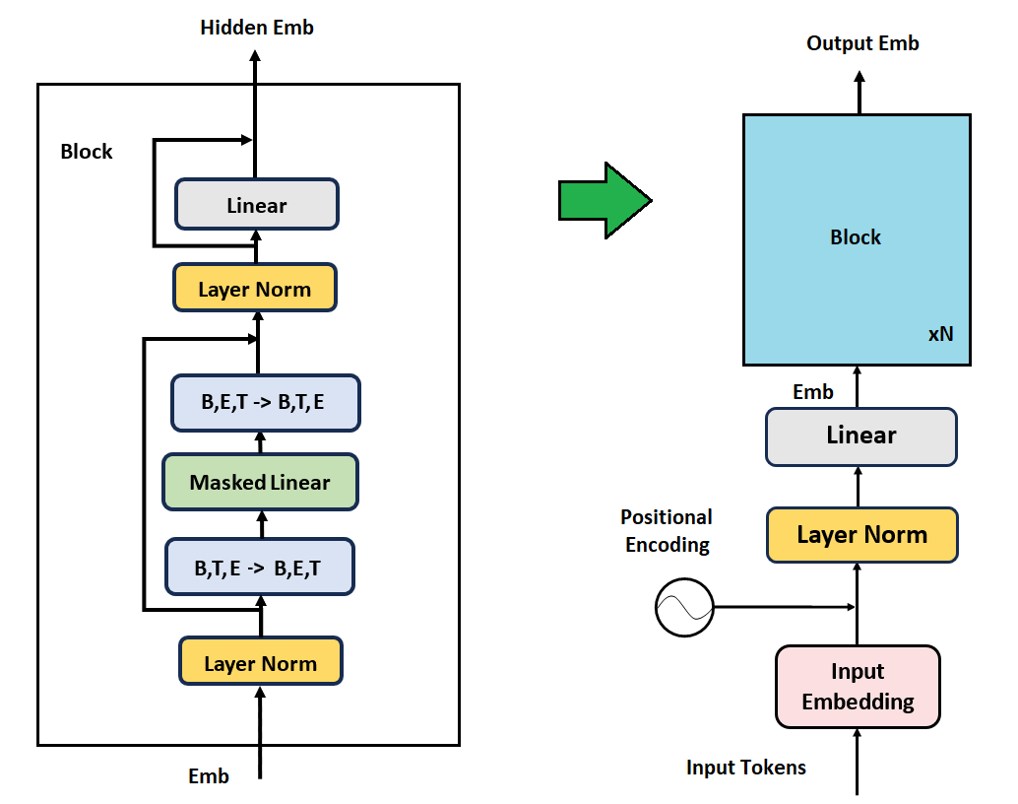
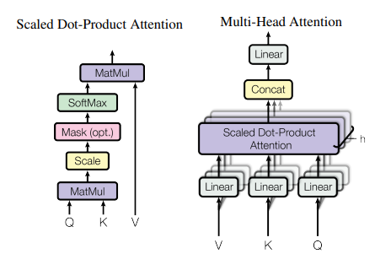
Original Transformer FeedForward Transformer

Slide 6
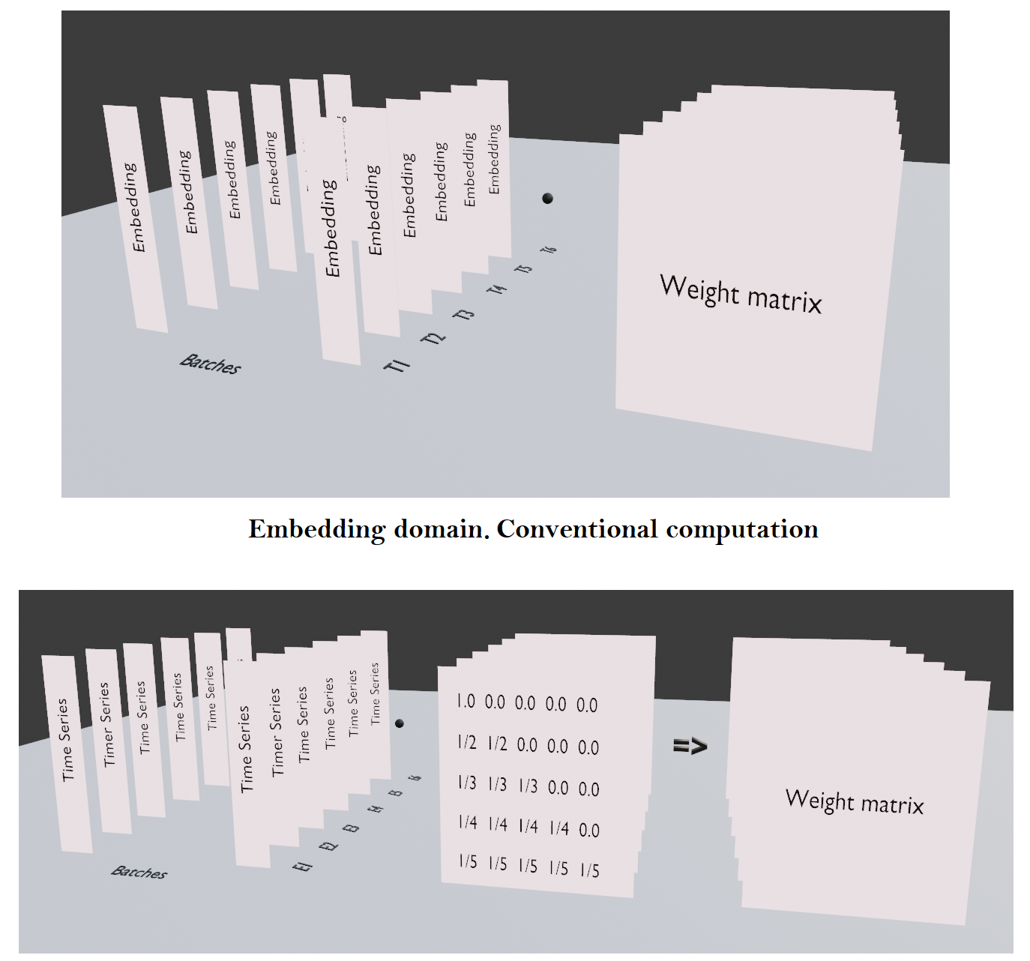
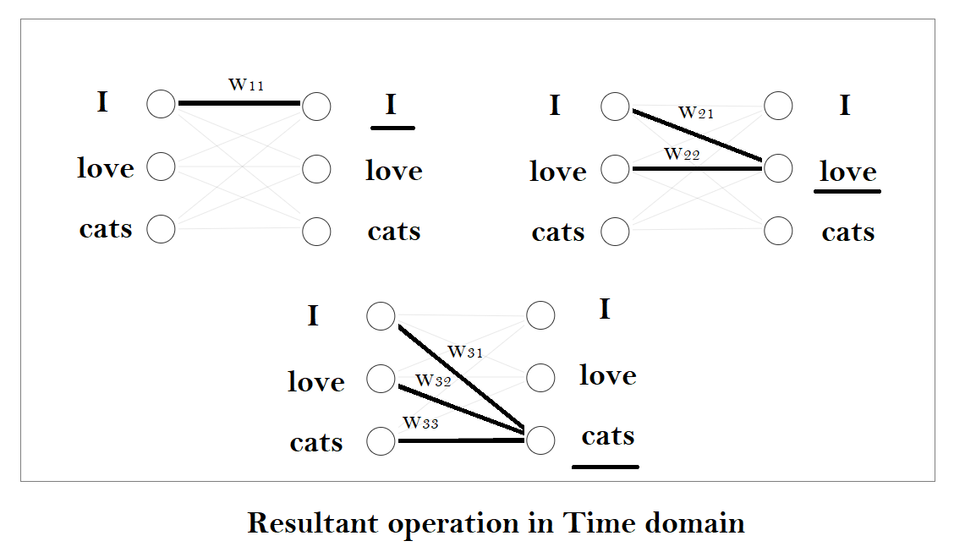
“The sculpture is already complete within the marble block, before I start my work. It is already there, I just have to chisel away the superfluous material.” Michelangelo
LLM takes input in the form:
Batch, Sequence of Tokens
Batch, Sequence, Vector
Batch, Vector, Sequence
Apply Triangular Mask

Slide 7
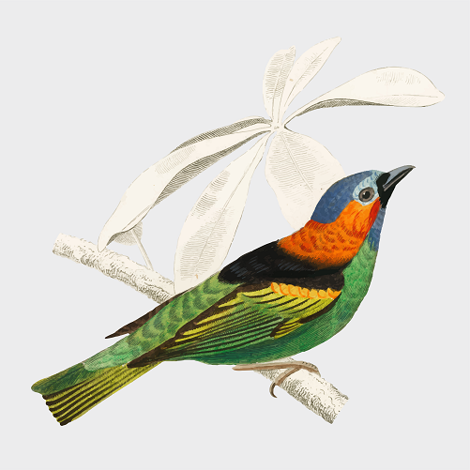

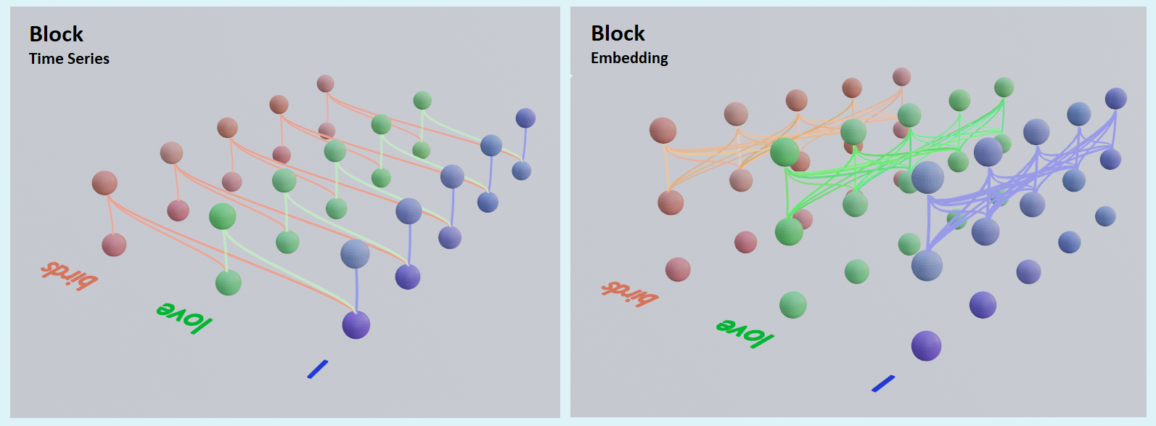
We made a simple next token regression model
Marusya was so playful with the ball. How I adore this ca[…]
Barsik was so playful with the mice. How I adore this ca[…]
97.6% Cat

Slide 8
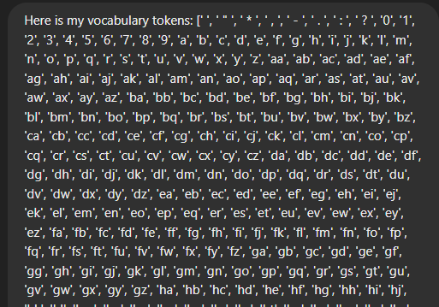
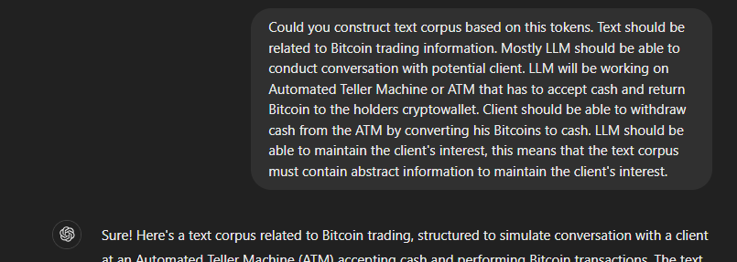
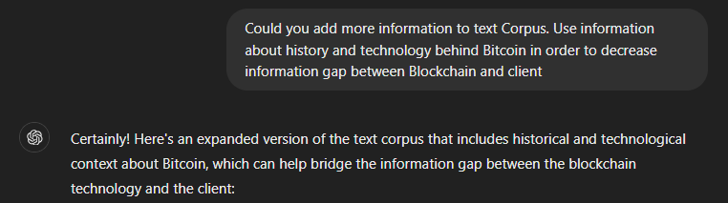
ChatGPT as Text Corpus Generator:

Slide 9
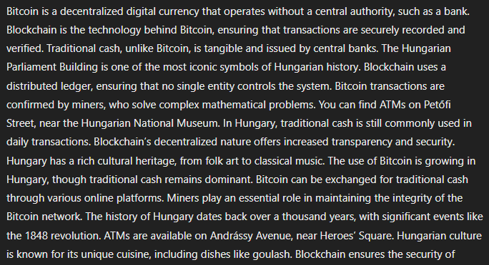
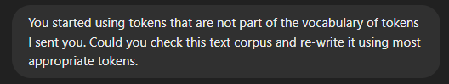
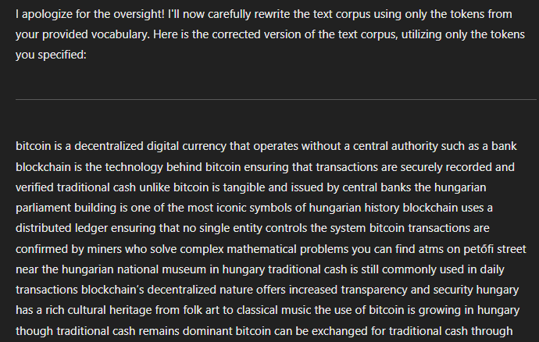

Slide 10
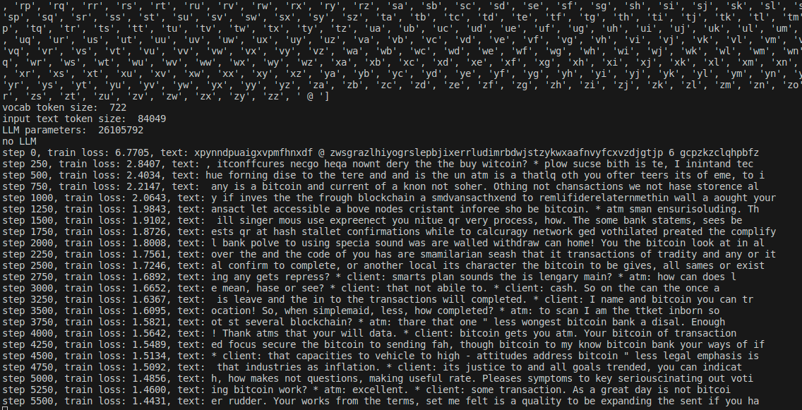
Simplified Self-Supervised Learning 0.1% of tokens replaced with “@”
Vocabulary: 722
Sequence Length: 450
Vector Length: 980
Layers: 10
Facets: 7
Learning rate: 3e-5
We need to train it until it stops producing grammatical errors

Slide 11
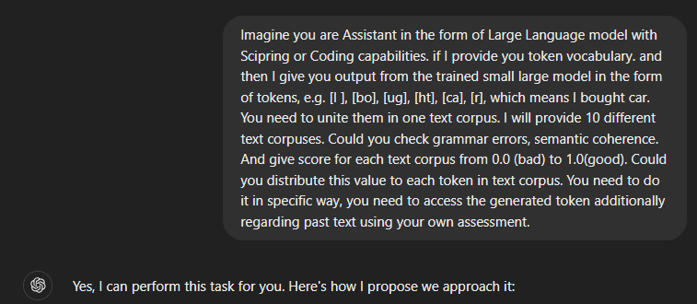
This is really fascinating. ChatGPT as Reward model

Slide 12
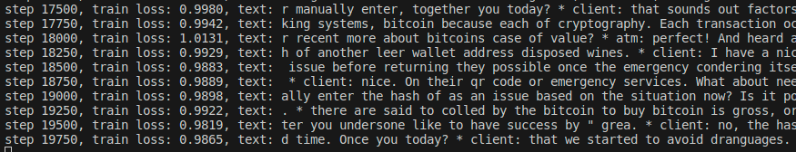
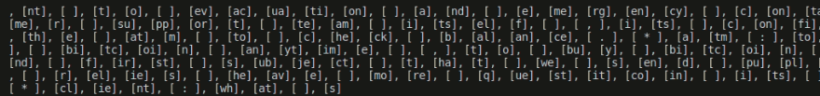
Stopped prematurely. It still makes a lot of errors, good to test now. Let us shift to ChatGPT webpage

Slide 13
Credits:
I always thank my Lord Jesus Christ for this opportunity. No other God died for our sins as “Punishment for sins is Death.” Cross=Love of God. Jesus Christ is my King.
https://www.freepik.com/author/macrovector
https://www.freepik.com/author/studiogstock
https://www.freepik.com/author/pongpongching
https://www.freepik.com/author/rawpixel-com
Images from Freepik.com

